Slide 1
Dax’s 1st project
Title : iron man’s adventure

Slide 2
What’s the game about
Turn based RPG with ever progressive stages of game play
Player starts as Iron Man, who is clearing stages and in his adventure will be joined by other members of the avengers
Can be further developed into Pay to play by implementing character packs that can be purchased
Leveling system can be implemented in future updates

Slide 3
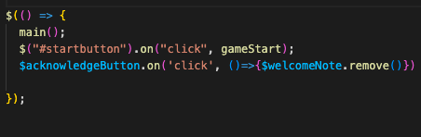
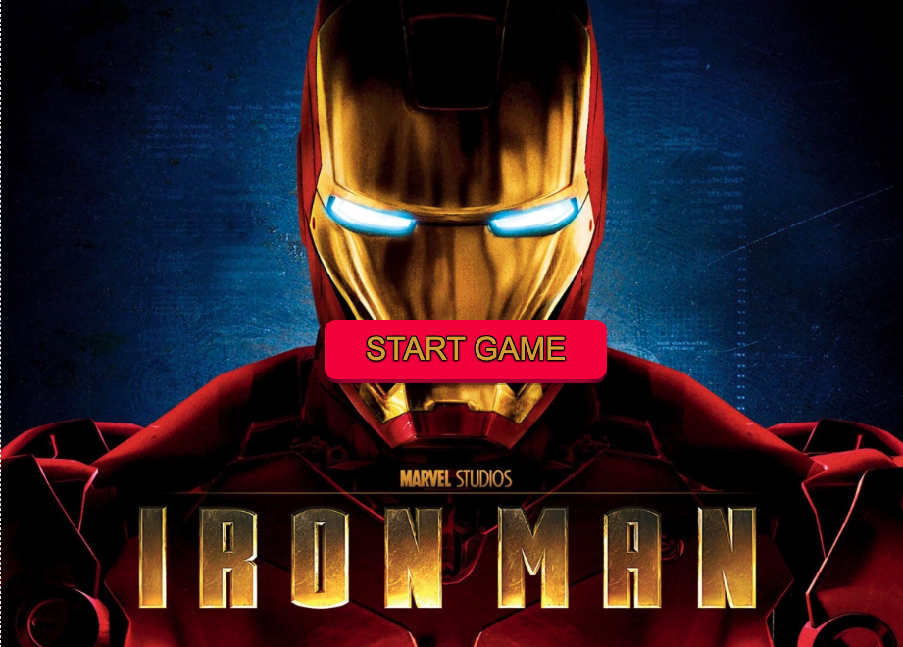
How it works : start page
Set up PG page button exit
Start button will initial the game

Slide 4
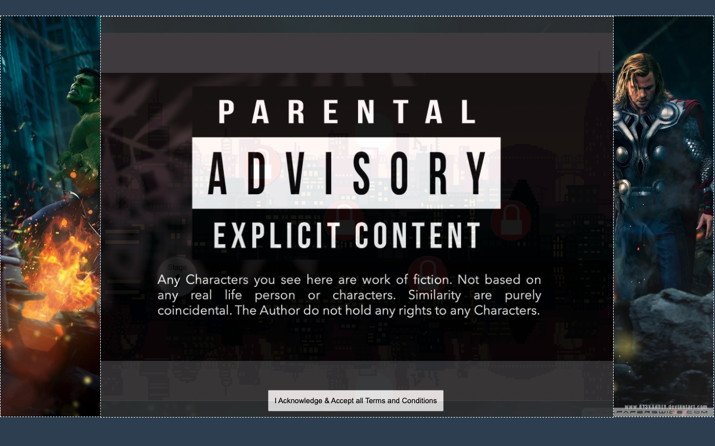
Pg page for good measure
Added just in case Marvel decides to take legal action.
Enforce reading of page by making sure people cannot exit it before 10 secs lapse.
Was intending to put in references but didn’t really get much info online

Slide 5
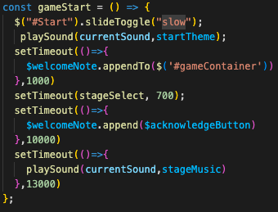
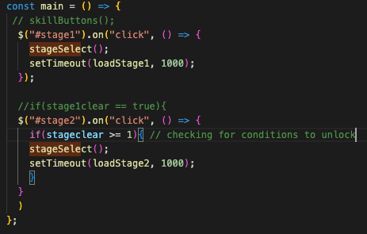
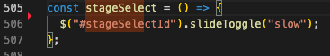
Setting up stage buttons listener
Actually I just want them to finish hearing the avengers music
Includes conditional checking so player is not able to play stages before the previous one is unlocked
stageSelect() is a toggle, hence its frequent appearance

Slide 6
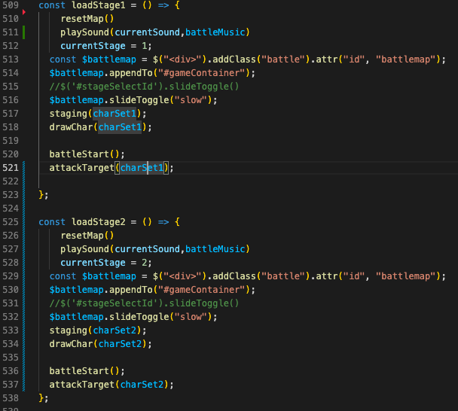

Main stage page
These are buttons with lock picture added by class in CSS. Always clickable, but only if unlocked will the player go into the stage.

Slide 7
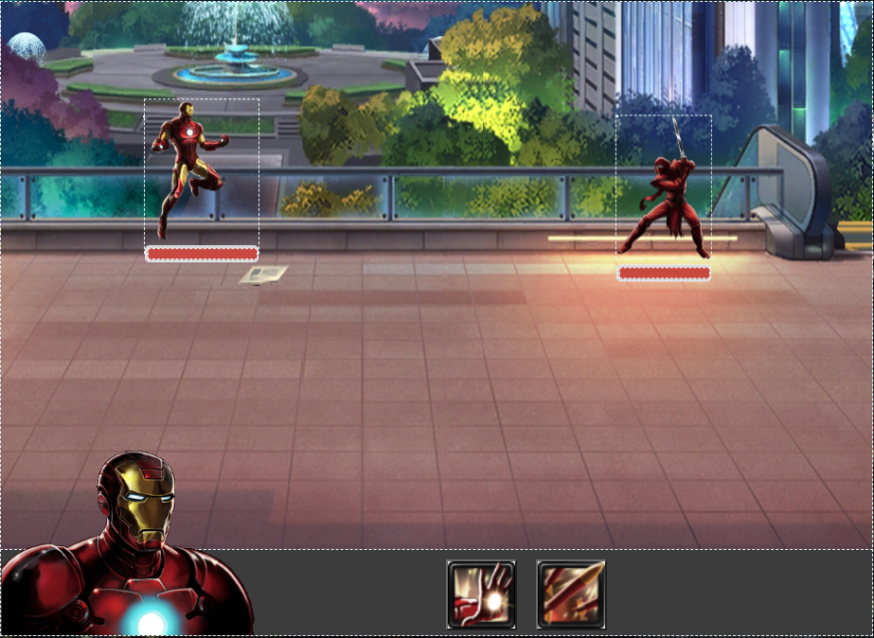
Battle scene : main regret – lack of soundclips
Looking for sound engineer to volunteer himself
STEP 1 : Load Footer
STEP 2 : Load Picture & button
----- the above steps determine characters’ turn. -----
Battle Sequence:
Click on button to select skill
Click on Villain to kick his butt !!
Step 2
Step 2
Step 1

Slide 8
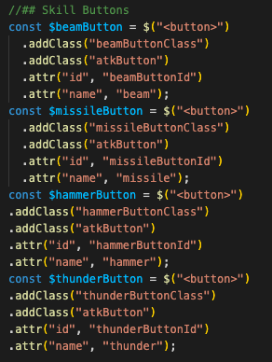
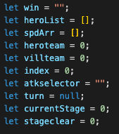
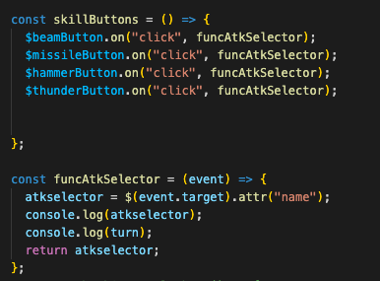
Button creation
Button changes atk selector value
Once Attack is selected, the Fun Begins

Slide 9
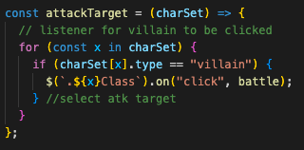
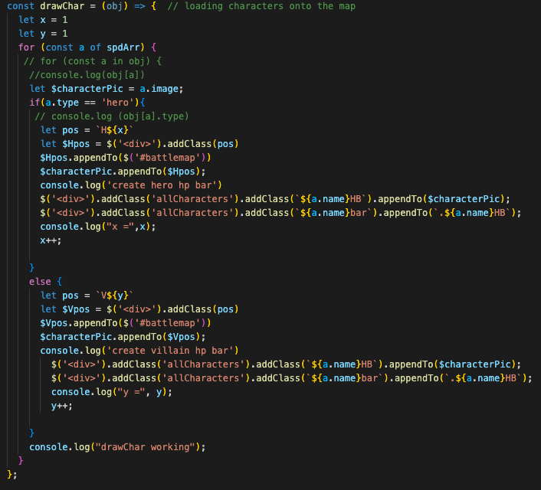
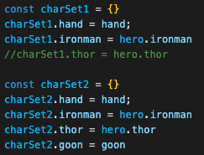
Mini functions
drawChar: => depending on who is in the stage object, load the character & health bar
attackTarget: => To allow us to click on the lucky Villain
This is the level parameter.

Slide 10
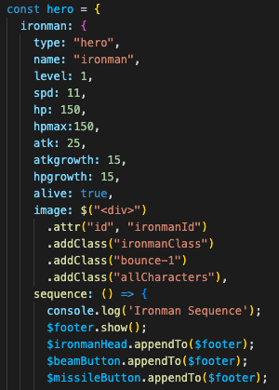
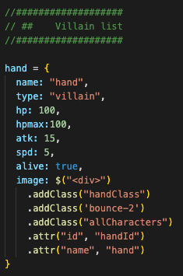
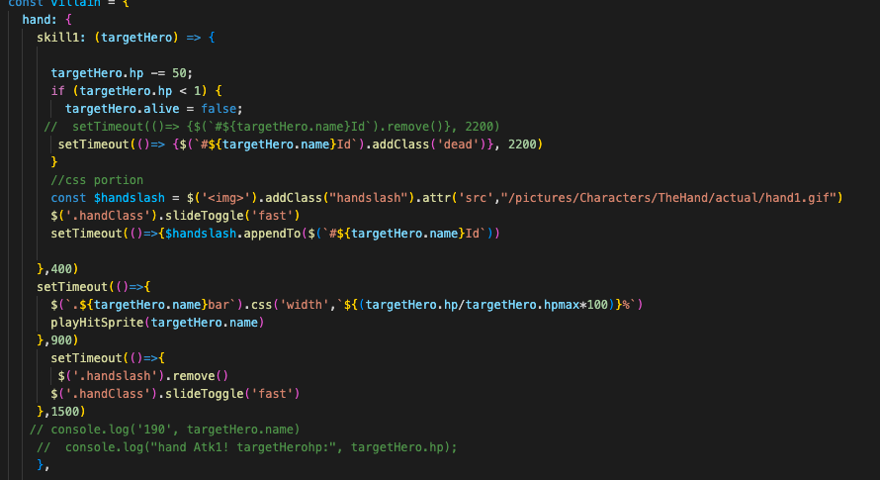
game object
If using OOP, this is probably in a separate file
Villain skills

Slide 11
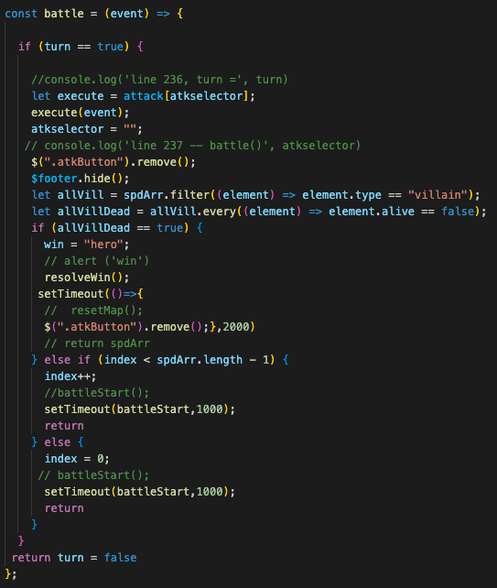
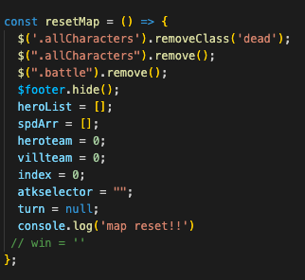
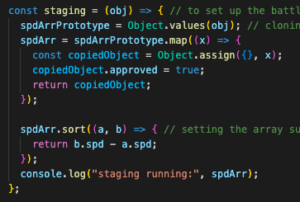
There are more functions… but its 3 am already and my wife is now an angry bird
Battle function: execute hero atk, see if all villains are dead, direct back to main batel sequence.
Not covered
main battle sequence
Hit sprite function
Melee atk targeter
Positioning tracking and returning etc
resetMap: cleaning up the dead bodies, cleaning up the streets etc. clear values to default
Staging : Set up Array for Battle sequence to work on, clone array, sort array by speed so fastest hero go first

